Slide 1

Emerging Technologies: Learning Analytics
New Jersey City University
CROSS-DISCIPLINE STUDIES IN TECHNOLOGY
Assessment 1: Group Members
Katy Blatnick-Gagne
Martha Osei-Yaw
Leonard Sheehy

Slide 2

Learning Analytics
Overview
Benefits and Limitations
Educational Applications

Slide 3

Overview of Learning Analytics
Learning Analytics is considered an emerging technology
Originally designed to track and analyze consumer spending trends
Data analysis and research are now being utilized to inform decision making in educational systems

Slide 4
Overview of Learning Analytics
Adaptive learning data provides insights about student interactions with online texts and courseware.
Analysis of education-related data can provide policymakers and administrators with indicators of educational progress to improve instruction.

Slide 5

Adaptive Learning Systems
Adaptive Learning Systems can be categorized into three distinct models (Esichaikul, Unknown).
Domain Model
Student Model
Adaptive Model

Slide 6
Adaptive Learning Models
The Domain Model can be viewed as a data repository that consists of topics, content or nodes related to the design structure of the represented data.
The Student Model stores all of the student information related to their domain knowledge, behavior and learning level.
The Adaptive Model incorporates adaptive theory by combining the domain model and the student model. The learning objectives and student levels are matched for student use.

Slide 7
Benefits of Learning Analytics
There are three groups that can benefit from Learning Analytics (Greller, & Drachsler, 2012)
Students
Teachers
Educational Institutions

Slide 8

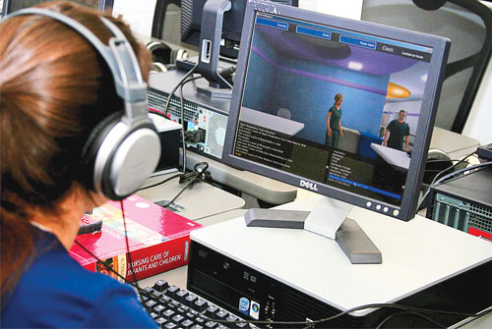

Student Benefits
Through the use of Learning Analytics, students can be supported by learning processes geared to their own abilities
Students will be able to reflect on their performance and compare it to the performance of others
Recommendations can be made for each student which will allow them personalized learning experiences

Slide 9
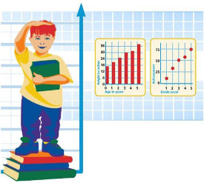
Teacher Benefits
Learning Analytics will help improve curriculum design and delivery
Teachers can be provided with real-time knowledge gap analysis for each student via course monitoring systems (CMS)
Teachers will be able to focus on students that are not understanding the material, while allowing others to work ahead when applicable

Slide 10
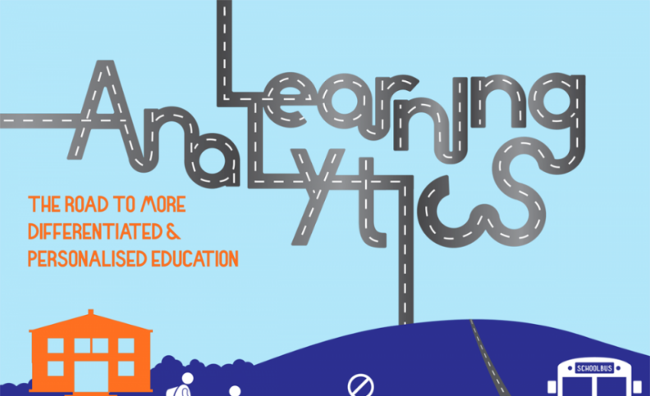
Educational Institution Benefits
By developing student-centered learning environments, schools may see a decrease in drop-out rates
Schools will be able to gather and analyze large amounts of data about each student’s learning strengths and weaknesses
Allow for better pedagogy
Learner ownership
Improved professional development

Slide 11

Limitations to Learning Analytics
Dependent upon large amounts of data for each student
Tests
Assessments
Online environments
Currently there is not one common method for mining the data
District to District inconsistencies
State to State inconsistencies
The systematic use of data to increase teacher effectiveness is relatively new to the educational system
This type of intentional data-mining is relatively new
Additional training must take place for all educators to be on a level playing field
(Corral ,2012)

Slide 12
Application of Learning Analytics
Better understanding of student learning
Immediate feedback
Real-time relevant information
Helps set goals

Slide 13
Application of Learning Analytics
Everyone doesn’t learn the same way.
Learning Analytics allows us to measure skills, knowledge, attitudes, personality traits and educational achievement.
This measurement is known as Psychometrics.
Individualized curriculum can then be tailored to the student’s specific needs.

Slide 14
Applications of Learning Analytics
Focused on improving learning and teaching
Content analysis – uses data captured from a student’s essay and to provide remediation if necessary
Discourse analysis – reviews statistics on how a person interacts with others
Can be used to evaluate a member’s contributions to a project then recommend correction
Social Learning – data from interactions on social media is used to find the interests of a student enabling a designer to create a learning system that might be more motivating to the student
Disposition analysis – applies data on a student’s character
For example if a student asks a lot of questions it is in their nature to be curious

Slide 15
Automated essay scoring analyzes both the coverage of content information, text complexity and the quality of student expression.
Application of Learning Analytics

Slide 16
What is significant is that modifications in curriculum can now be implemented instantly as a child uses new virtual learning environments because the software can immediately redirect a student's learning based on their responses. I call this real time curriculum.
Application of Learning Analytics

Slide 17
Conclusion
Adaptive Learning is an emerging field, by realizing its potential benefits we will be able to improve student performance and allocate resources adequately.
As the body of knowledge around Learning Analytics continues to grow, leaders will be much more informed about how to use it to guide learning outcomes and educational policy (NMC Horizon Report, 2014).
It appears as though we are still at the very early stages of seeing the research findings combined with commercially viable solutions that have achieved traction in academic settings (Newman, 2013).

Slide 18
The End

Slide 19
Booth, Melanie. Learning Analytics: The New Black EDUCAUSE Review (2013) Corral, J. (2012). Learning analytics: The possibilities and the unknowns for medical education. Retrieved from https://www.aamc.org/members/gir/295490/june2012viewpoint-learninganalytics.html Ellis, C. (2013). Broadening the scope and increasing the usefulness of learning analytics: The case for assessment analytics. British Journal of Educational Technology, 44(4), 662-664. doi:10.1111/bjet.12028 Greller, W., & Drachsler, H. (2012). Translating learning into numbers: A generic framework for learning analytics. Journal of Educational Technology & Society, 15(3), 42-57. Esichaikul, V. (Unknown). Student modeling in adaptive e-learning systems. Knowledge Management & E-Learning: An International Journal, Vol. 3, No. 3. Newman, A. (2013). 2013: The year of adaptive learning. Retrieved from: http://www.impatientoptimists.org/Posts/2013/04/2013-The-Year-of-Adaptive- Learning.
Bibliography

Slide 20
Bibliography
Greller, W., & Drachsler, H. (2012). Translating learning into numbers: A generic framework for learning analytics. Journal of Educational Technology & Society, 15(3), 42-57.
New Media Consortium. (2014). Horizon report: K-12 education edition 2014. Available online at http://www.nmc.org/publications/2014-horizon-reportk12
Slade, S., & Prinsloo, P. (2013). Learning analytics: Ethical issues and dilemmas. American Behavioral Scientist, 57(10), 1510-1529. doi:10.1177/0002764213479366
Society of learning analytics research (2013). Computational Approaches to Analyzing Student performance: Methods and Applications Retrieved on September 26, 2014 from http://solaresearch.org/?s=application&submit=Go

